Slide 1
MULTIDISTRICT PETS ALLIANCE

Slide 2
CURRENT STATUS
Looking at the past, present, and future
What’s Happened?
What’s Happening Now?
What’s Happening Next?

Slide 3
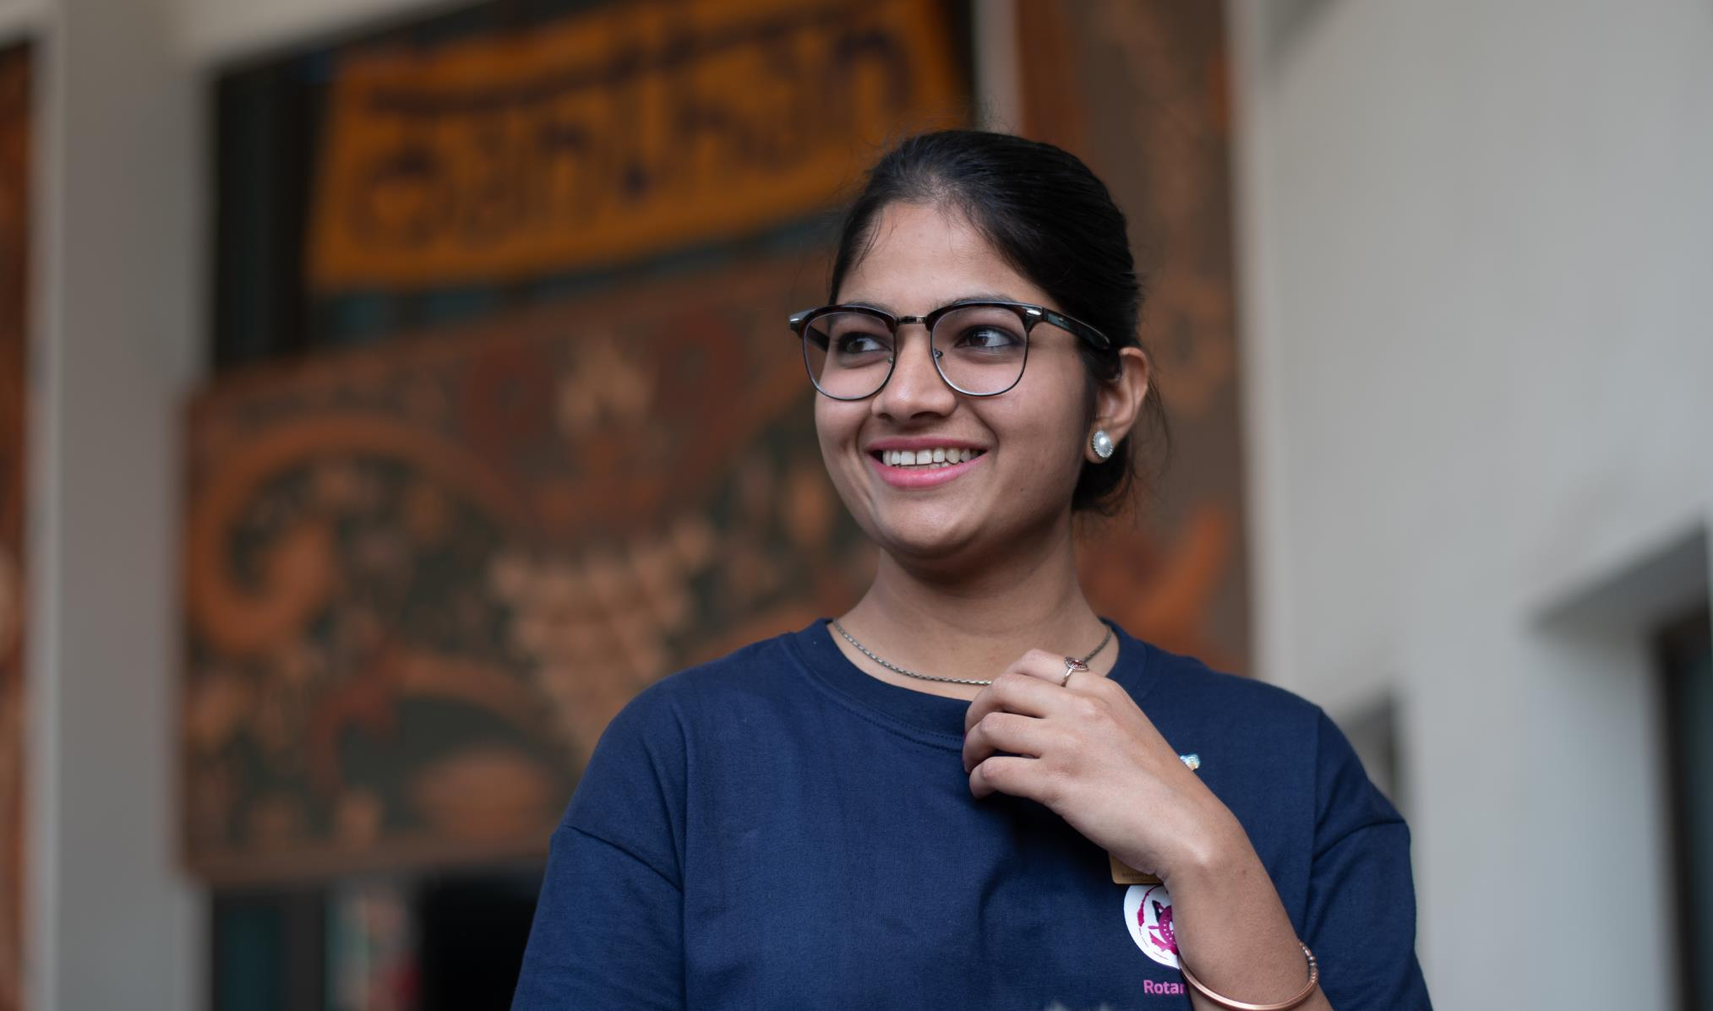
WHAT’S HAPPENED?

Slide 4
Staff Support
Effective November 2021, Rotaract transitioned from being supported by the Programs for Young Leaders team to all staff of Rotary and The Rotary Foundation.

Slide 5
Additional Club Roles
Previously, Rotary recorded the Rotaract club:
From February 2022, Rotary now records the Rotaract club:
president
advisor
secretary
treasurer
membership chair
Foundation chair
service projects chair
public image chair

Slide 6
April 2022 The RI Board reaffirms that growing Rotary remains the organization’s top internal priority and amends the Rotary Code of Policies to include a new section on the Grow Rotaract Membership Operational Plan (RCP 12.120).
Rotaract Operational Plan
Includes 15 business objectives aligned with Rotary’s strategic priorities:
Increase Impact
Expand Reach
Enhance Engagement
Increase Ability to Adapt

Slide 7
Rotaract Dues
April 2022
First invoice to be released in 2022-23 Rotary Year, then annually, based on membership as of 1st of the month of invoice distribution
Rotaract club per capita dues are payable on 1 January of each year.
Per capita rate of US$5 per university-based, US$8 per community-based
US/US territories will also include nominal assessment for insurance
Pro-rata to be collected on next, annual invoice
Termination and reinstatement processes for non-payment of RI dues

Slide 8
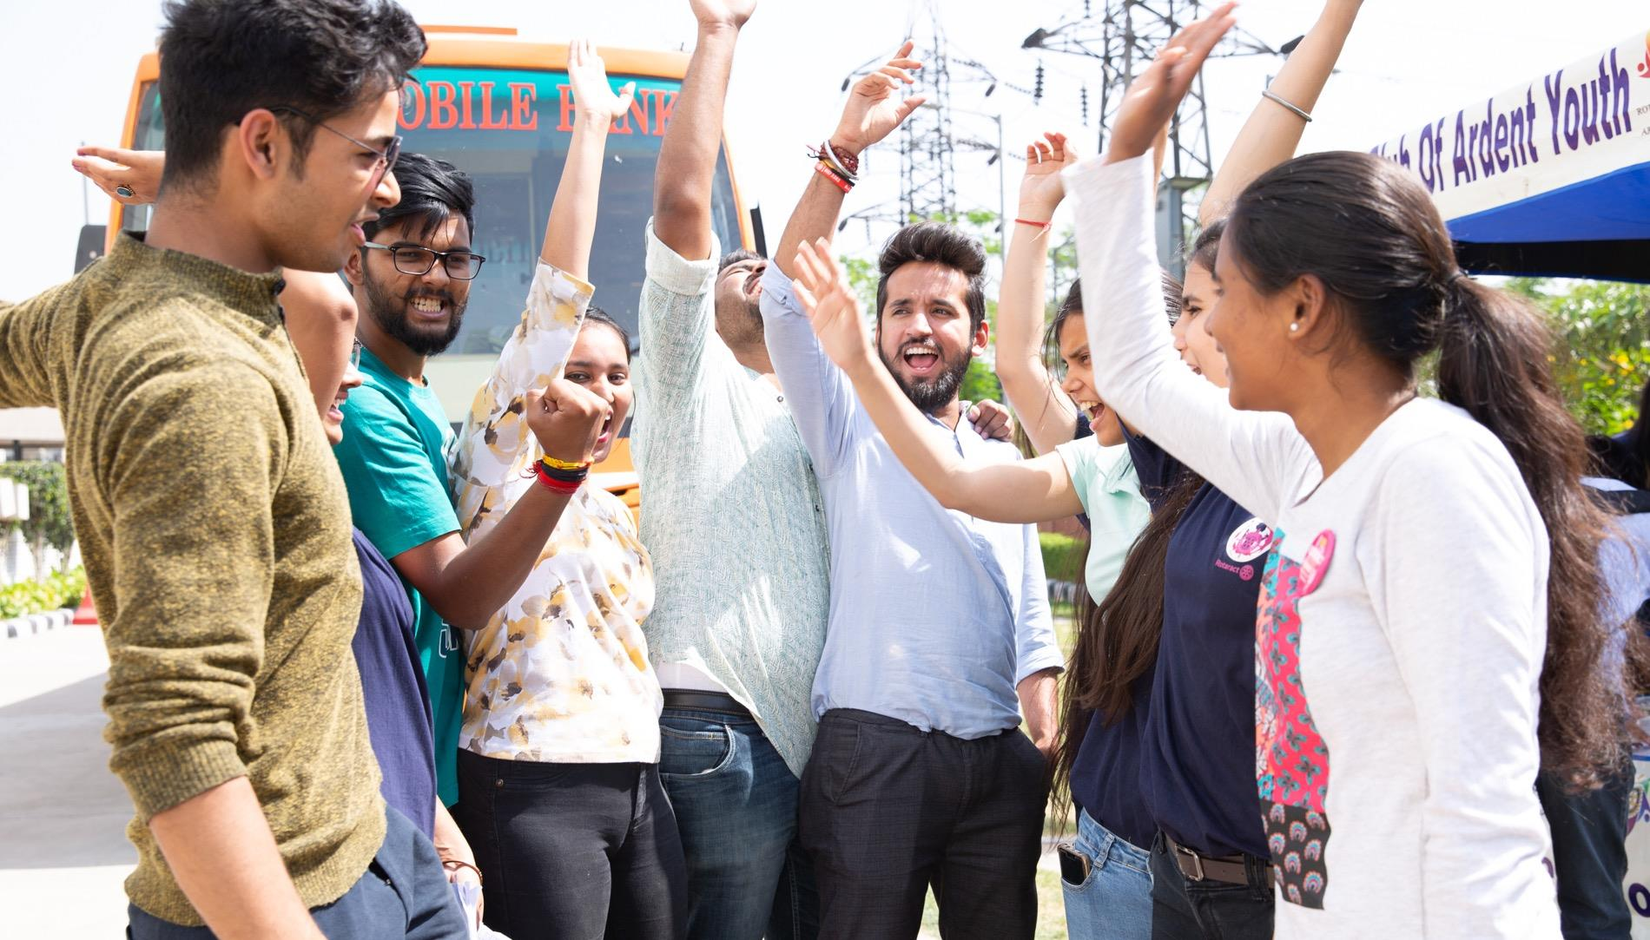
ROTARACT IS ELEVATED

Slide 9
Changing Our Communications
Inclusive language
If we’re referring to RI’s membership (including Rotaract), we use “Rotary members” rather than “Rotarians.”
We can also say “our members,” “our clubs,” “clubs and districts,” or “people of action.”
When we want to be more specific, we can use “Rotary and Rotaract members” and “Rotary and Rotaract clubs.”

Slide 10
Changing Our Communications
Rotaractors are people of action who are part of Rotary’s global network and committed to developing innovative solutions to the world’s most pressing challenges.
In communities worldwide, our members – both Rotarians and Rotaractors - work together for sustainable change.
Rotary’s membership includes 1.4 million people of action around the globe. Working together, 1.2 million Rotarians and 220,000 Rotaractors in more than 46,000 clubs are helping communities worldwide bring about positive change.

Slide 11
Enhanced Experiences
Prospective Member Leads Management | Phase 1 (March 2021)
“Join” form and +Add Lead button
club type added to emails, Leads page, and Details page
Resources & Communications updated to be inclusive of Rotaract
Club Health Check
officer/leader courses & curriculum

Slide 12
As of July 2022
Eligibility for Awards
ROTARY INTERNATIONAL
Avenues of Service Award
Significant Service Award
Service Above Self Award
Sylvia Whitlock Leadership Award
THE ROTARY FOUNDATION
District Foundation Service Award
Citation for Meritorious Service
Distinguished Service Award

Slide 13
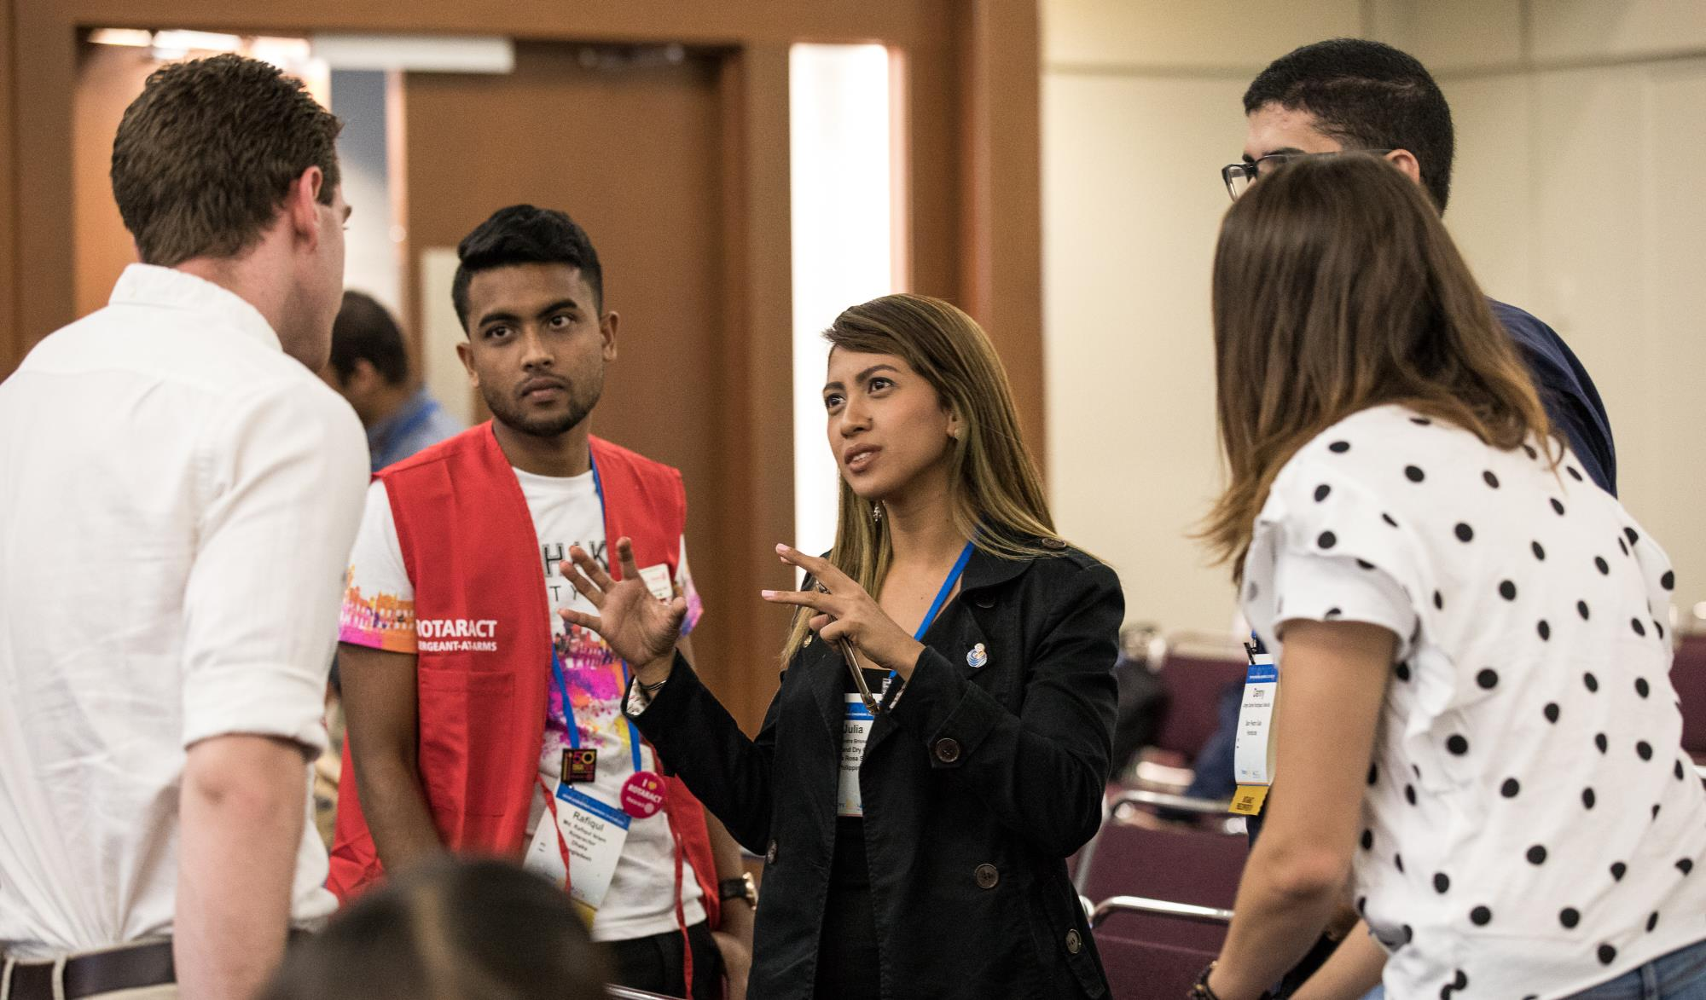
WHAT’S HAPPENING NOW?

Slide 14
Rotary Grants
Rotaract clubs are allowed to be either the international or host sponsor of a global grant beginning 1 July 2022, provided they have previously partnered with a Rotary club on a global grant
The Grants Center will allow Rotaract clubs to be formally recognized as a donor or partner on a global grant application

Slide 15
My Rotary Enhancement
Prospective Member Leads Management | Phase 2
referral form
rejoin/relocate form
A better Rotaractor experience
Ability to search for other members, view each other’s profiles
Rotaract clubs integrated into club search
District profile pages update to include Rotaract clubs and members
District dashboard update to include Rotaract data
Complete refresh of Rotaract administration functionality

Slide 16
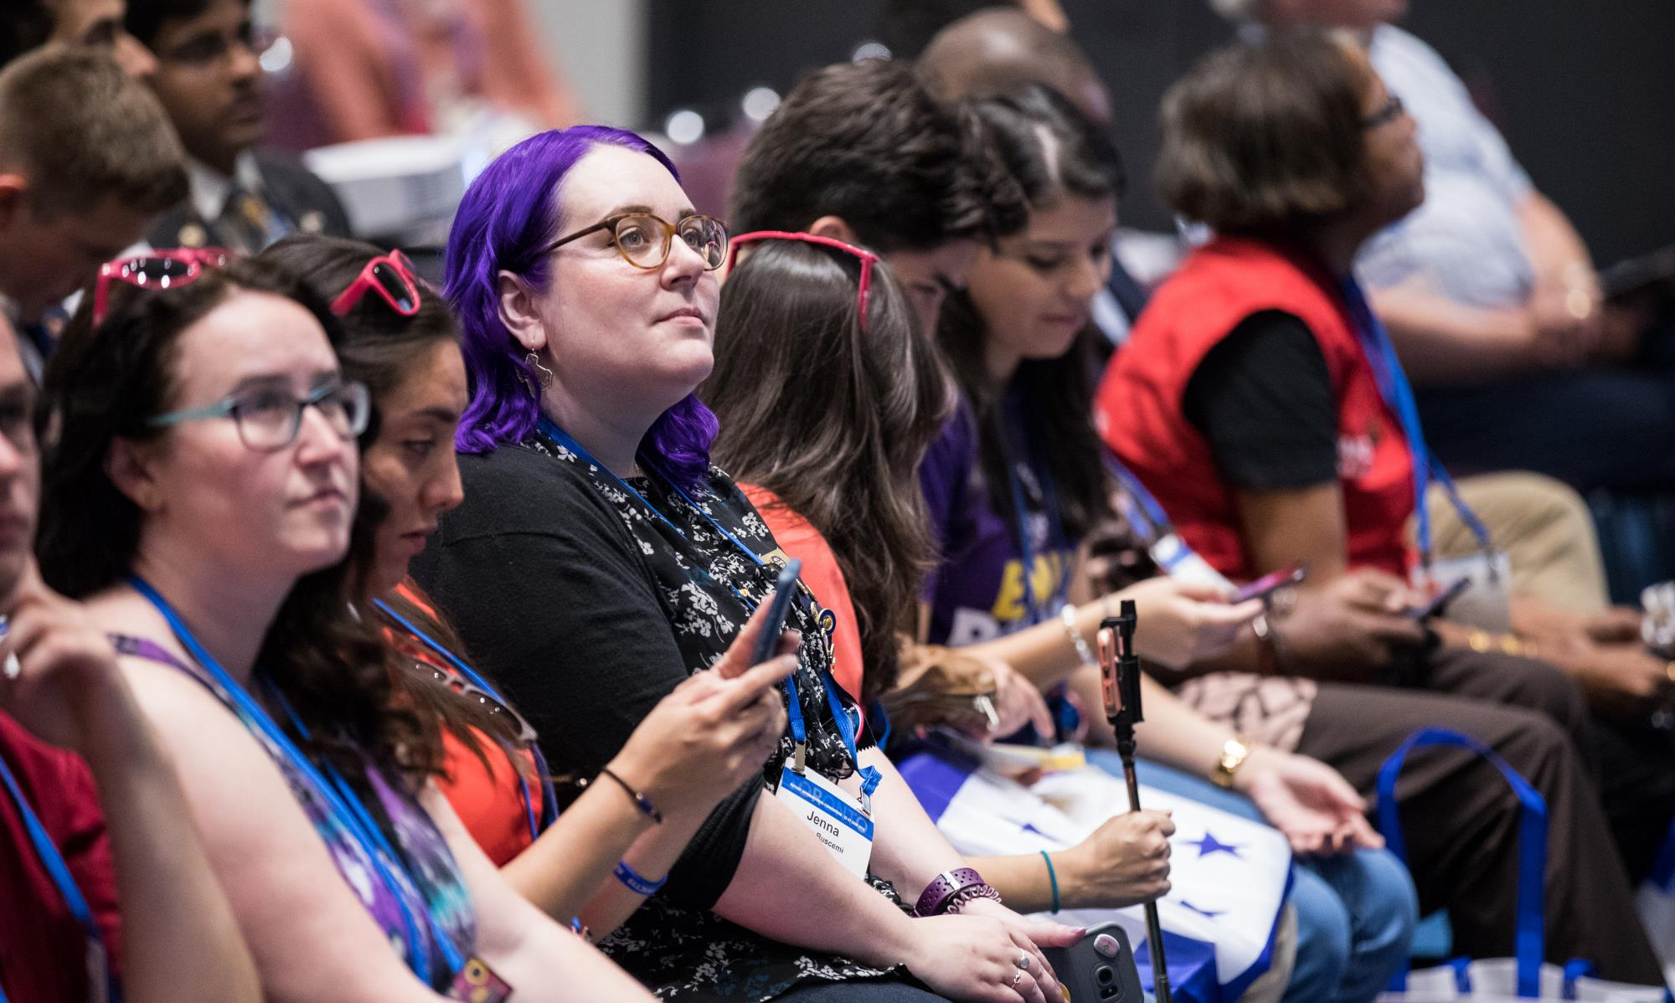
WHAT’S HAPPENING NEXT?

Slide 17
Rotary Club Central
launch club administration enhancements (Quarter 1)
refresh of My Rotary and rotary.org
first Rotaract club invoice (January 2023)
World Rotaract Week (2023 and beyond)
Rotary Club Central

Slide 18
Rotary International Conventions 2023 - 2025
Starting in 2023, we’ll be incorporating the Rotaract Preconvention into the Rotary International Convention capturing many of the favorite elements in our main event!
By taking a pause in holding separate events through 2025, we can make sure that we are hosting a more inclusive event that enhances the experiences of all our members.

Slide 19
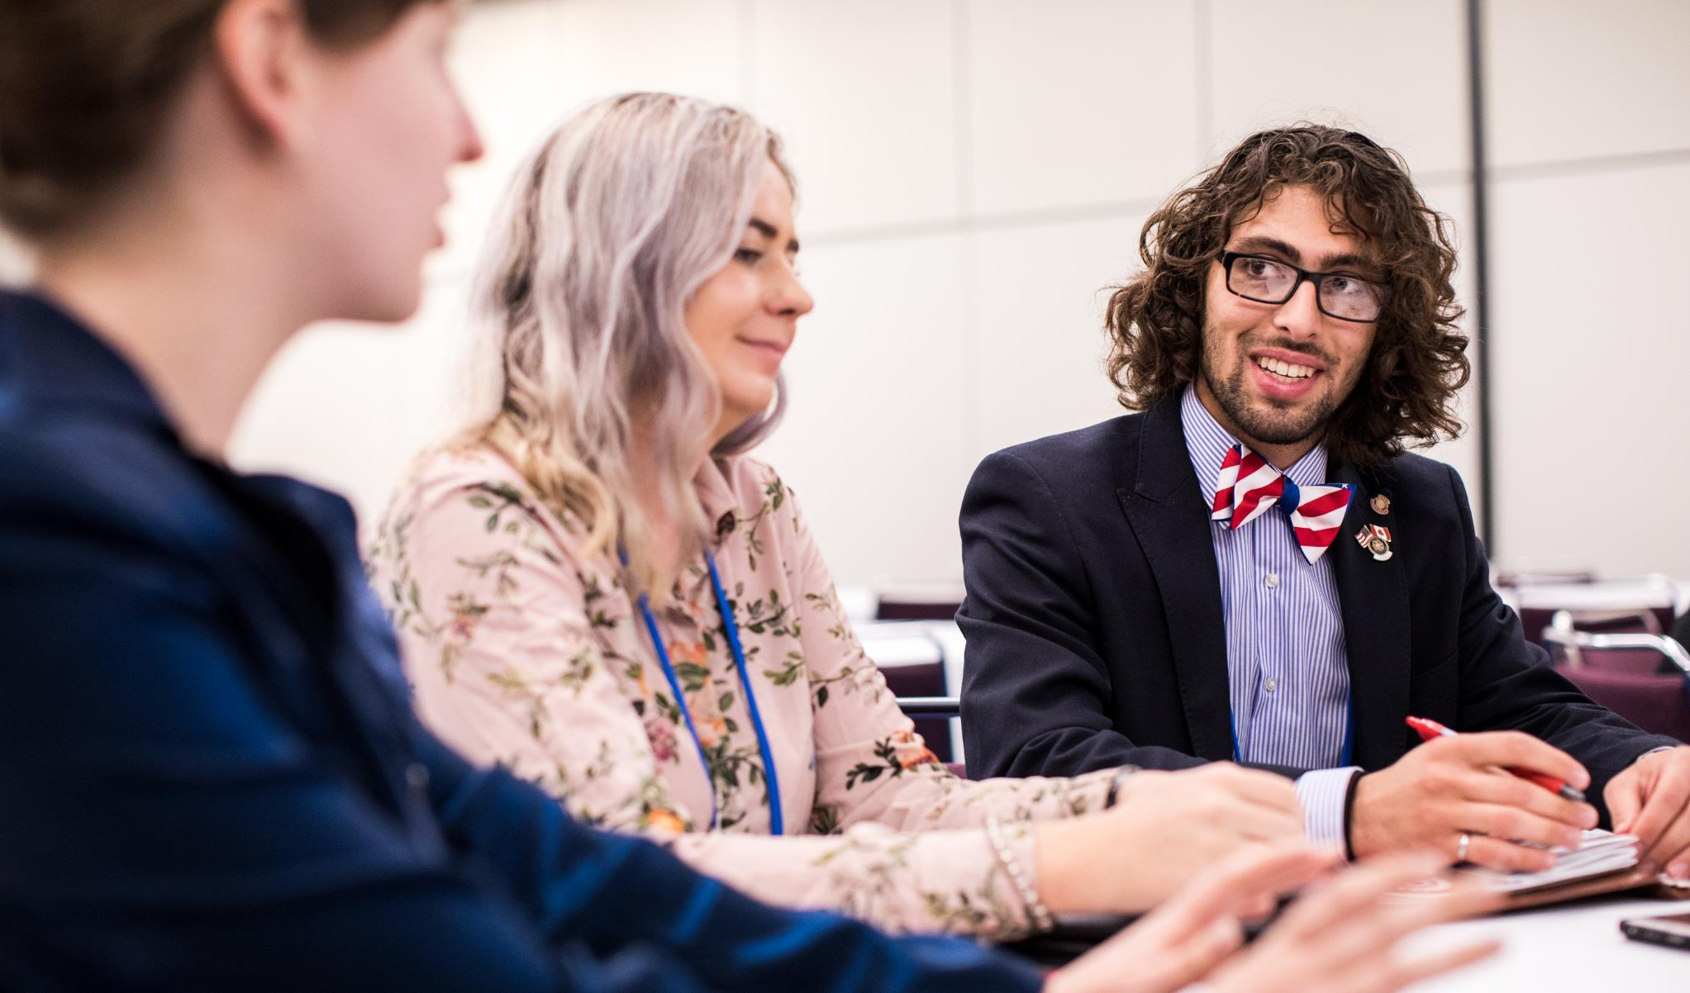
WHAT ABOUT
TRAINING?

Slide 20
DOES YOUR EVENT…
Already include a track for Rotaractors?
Have plans to create a track for Rotaractors?
See a need for Rotaractors to be trained separately?
Have Rotaractors involved on the planning committee?

Slide 21
QUESTIONS?

